Slide 1
Anubhav Nehru
Krittika Deshwal
Nikhil Nair
Simran Kaur

Slide 2
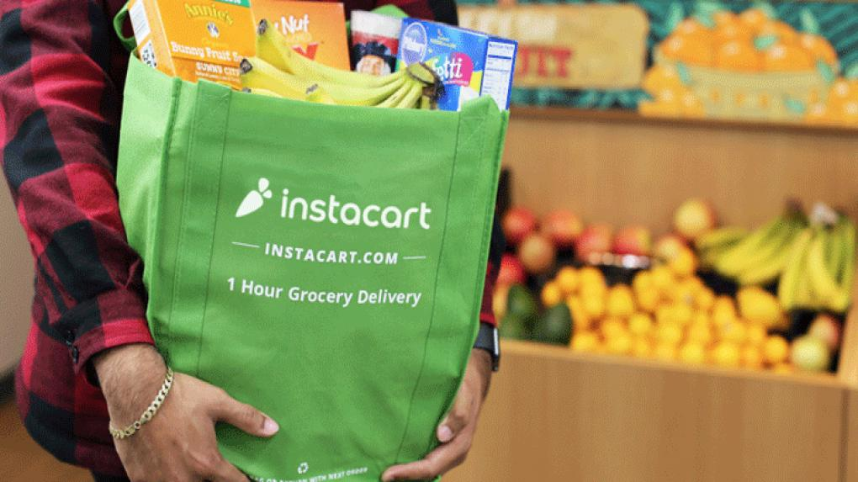

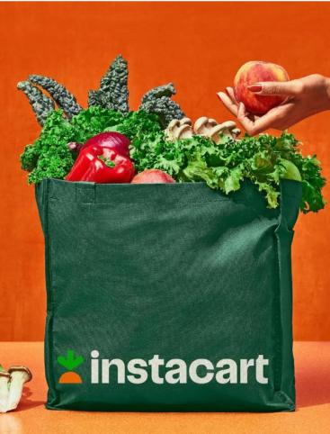
Problem Statement
Market basket analysis is crucial for retailers to understand customer shopping behavior and improve decision-making. Utilizing customer transaction data and overcoming data management challenges, businesses can enhance product placement and customer experience, especially in the online grocery sector like Instacart.
Understanding Customer Shopping Behavior
Identify different customer segments based on their purchasing behavior
Predict which products are likely to be reordered
Department and aisle analysis
Understand peak purchasing times and days of the week for targeted promotional activities

Slide 3
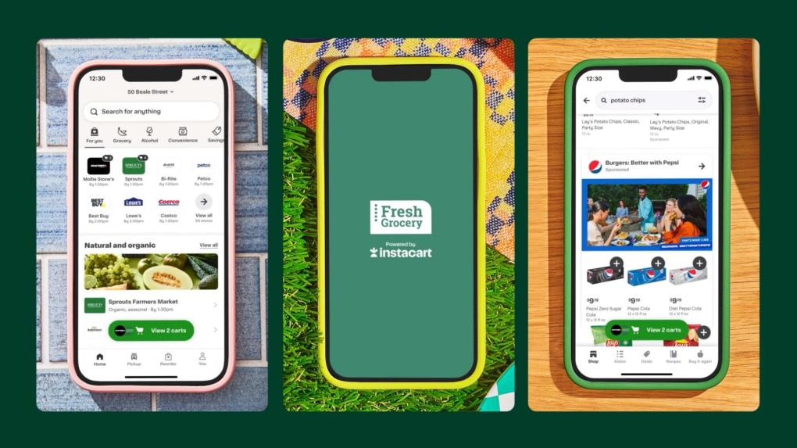
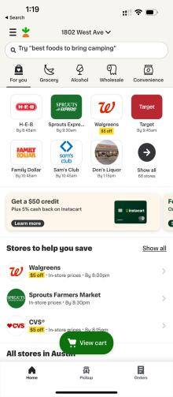
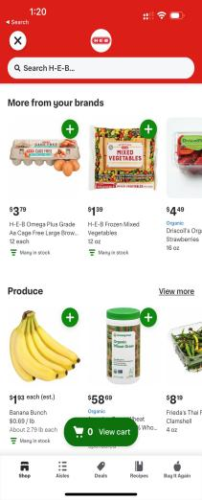
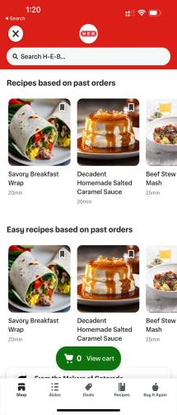
Personalization Level Max!

Slide 4
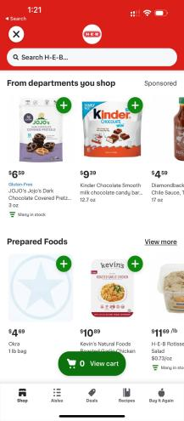
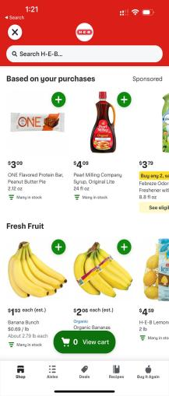
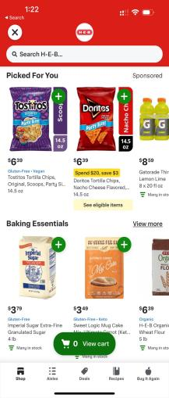
Personalization Level Max!

Slide 5
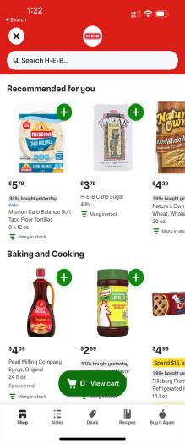
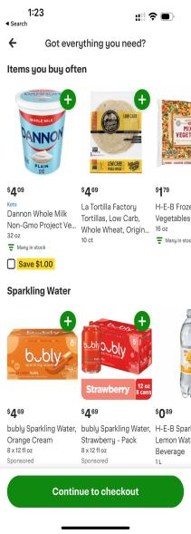
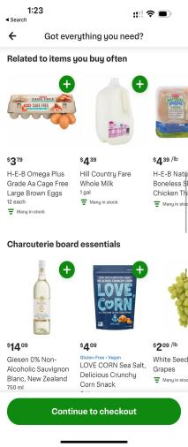
Personalization Level Max!

Slide 6
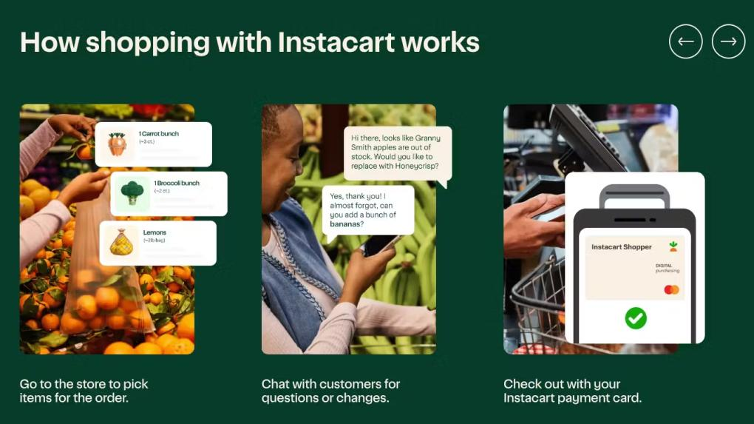
What’s the value of a recommendation?
By a customer’s 10th order, 25% of all conversions are from the
“Your Items” List!
Notes:
Over time consumers become more reliant on their personalized
list of previously purchased items!

Slide 7
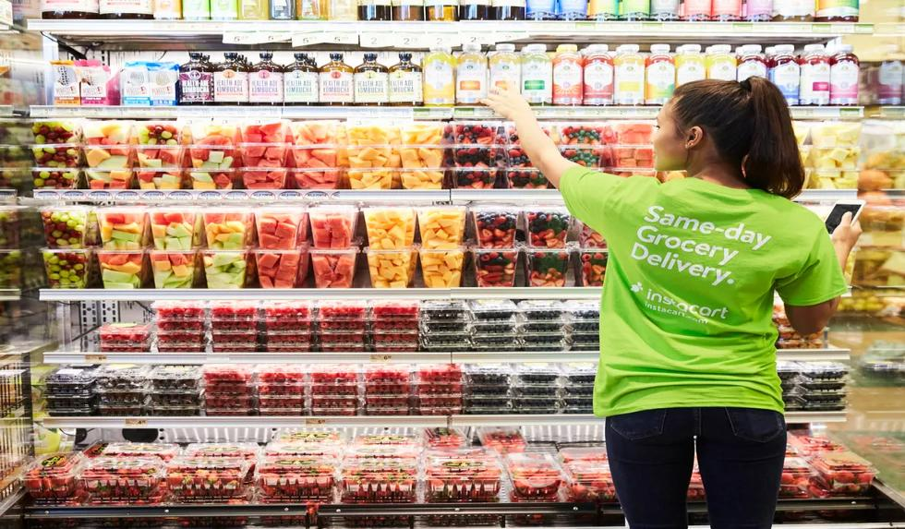
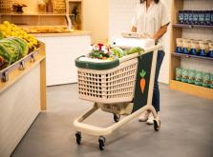
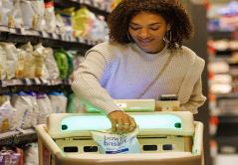

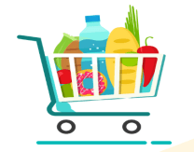
The Scale of our Data!
20M + Total Orders
134 Aisles
50k+ Products
21 Departments

Slide 8
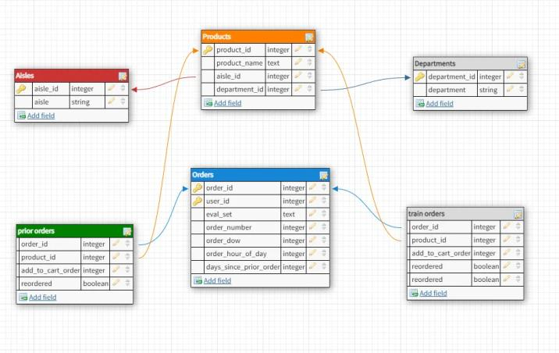
Data at Glance
20M + Total Orders
50k+ Products
134 Aisles
21 Departments

Slide 9
Let’s Deep Dive!
EXPLORATORY DATA
ANALYSIS

Slide 10
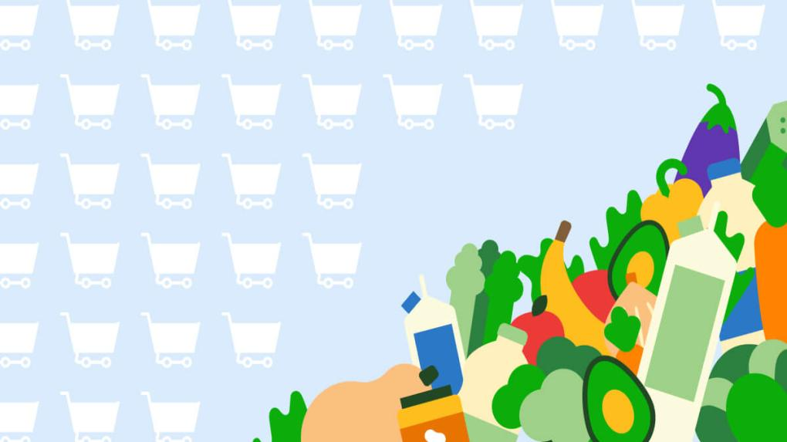
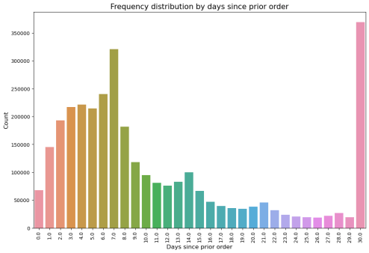
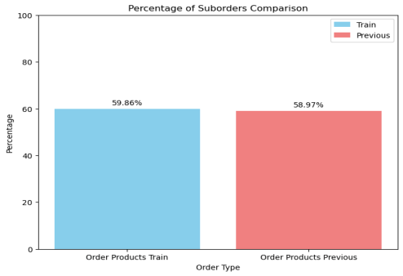
Order Frequency Analysis
Most orders are re-ordered either within 7 days or after 30 days, implying frequent buyers and bulk buyers
60% of the products are re-ordered

Slide 11
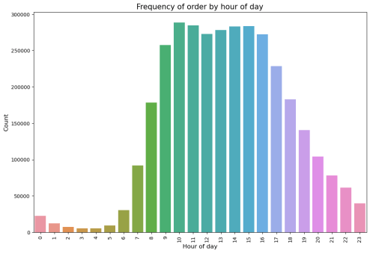
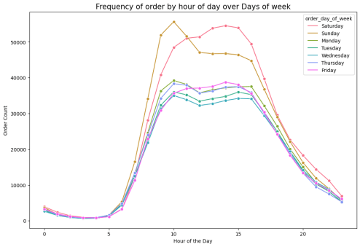
Order Frequency by Time and Day of the Week
Most of the orders are placed during
9AM to 5PM
There is a prominent peak of Order Count on the weekends

Slide 12
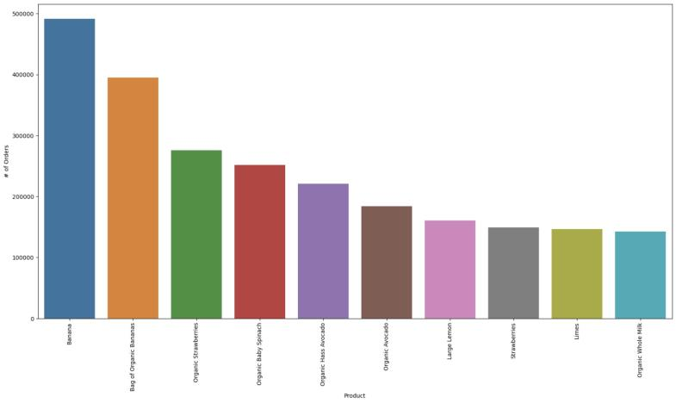
Best Selling Products
Most of the best selling products are organic fresh fruits and vegetables.

Slide 13
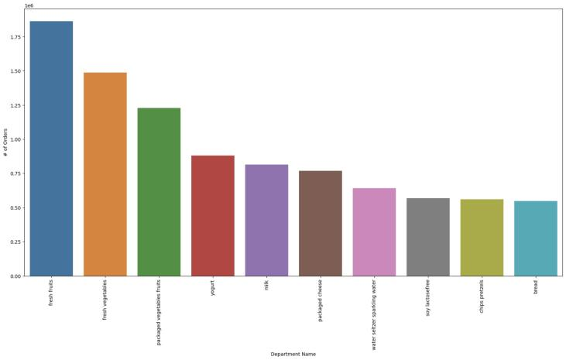
Best Selling Aisles
Most of the best selling aisles are organic fresh fruits and vegetables, and daily consumables like dairy products
Aisles

Slide 14
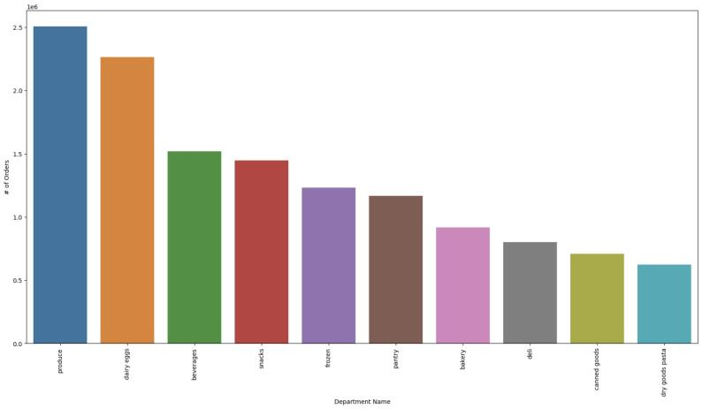
Best Selling Departments
Most of the best selling departments are produce, and daily consumables like dairy products, snacks, and frozen items.

Slide 15
Let’s Deep Dive!
CUSTOMER SEGMENTATION

Slide 16
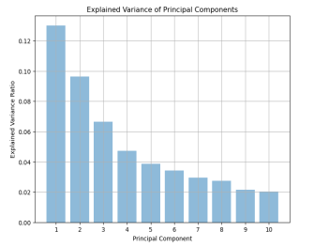
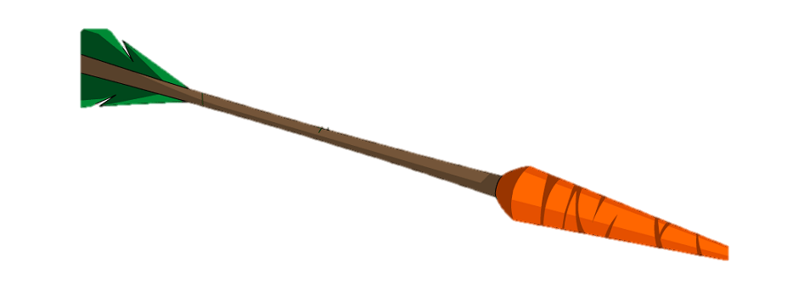
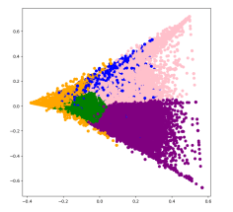
K-Means over PCA
- Since there are thousands of products, we rely on aisles, which represent categories of products.
- Even with aisles, we reduced features and used Principal Component Analysis to find new dimensions along which clustering would be easier.
- 5 Distinguishable Clusters by purchasing Behaviour
- Visualization of clusters among first 2 components.

Slide 17
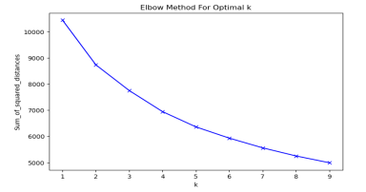

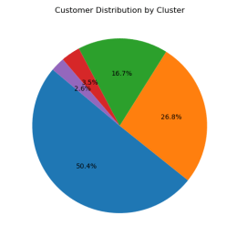
K-Means over PCA
- Optimal k value identified at 5. Distinguishable Clusters by purchasing Behaviour
- 50% customers in the largest cluster accounting for over 45% of the overall orders.

Slide 18
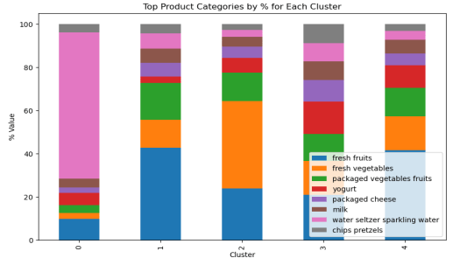
K-Means over PCA
- Each cluster respectively results into certain consumers having a very strong preference for (with some overlap):
0: water seltzer sparkling water aisle
1: fresh fruits & vegetables
2: fresh fruits & vegetables
3: yoghurt and milk

Slide 19
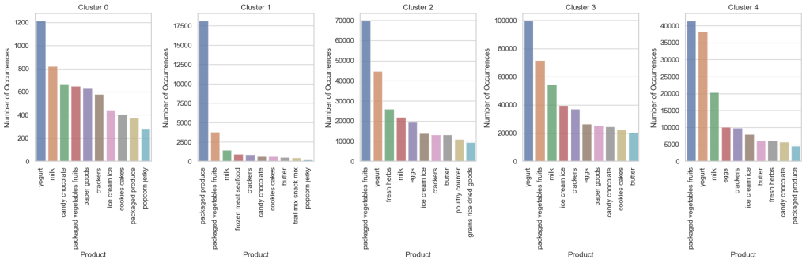
Cluster Statistics
Orders by Aisle Distribution for each cluster

Slide 20
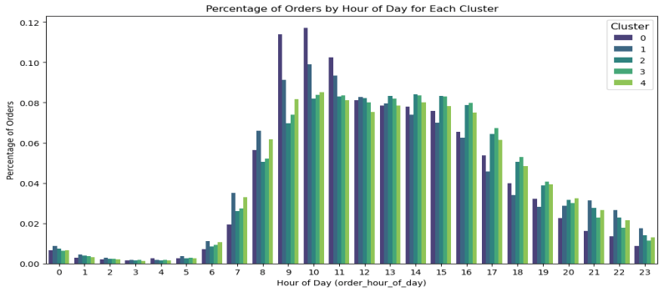
Cluster Statistics
A larger % of Health Enthusiasts order in early? Majority of the orders come in between 9 am – 4 pm

Slide 21
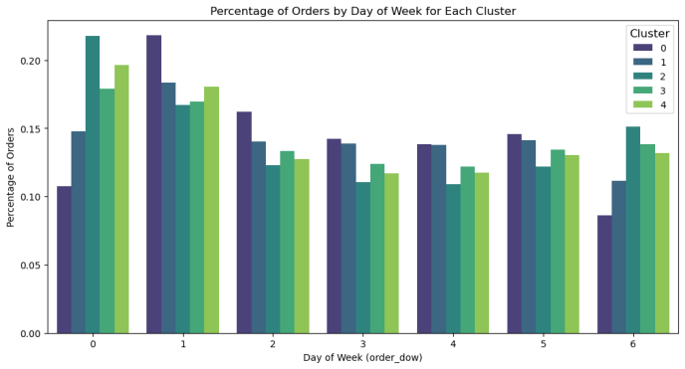
Cluster Statistics
Most orders at the start of the week particularly by veggie lovers and health enthusiasts

Slide 22
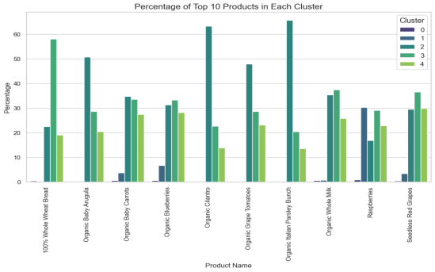
Cluster Statistics
Veggie Lovers and Diary Enthusiasts order popular products. Cross-sell opportunities exist for Health Enthusiasts and Snack Lovers.

Slide 23

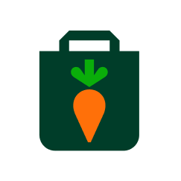
Identifying Clusters?
Health Enthusiasts
Snack Lovers
Veggie Lovers
Diary Enthusiasts
Balanced Shoppers

Slide 24
Cluster Statistics
Category
Health Enthusiasts
Snack Lovers
Veggie Lovers
Diary Enthusiasts
Balanced Shoppers
% Cust
2.2 %
3.5 %
27 %
50.5 %
16.6 %
% Orders
1.1 %
3 %
28.6 %
49.3 %
17.8 %
Median Orders
3
6
7
7
7
Order Gap
9
10
8
8
7
Basket Size
1
2
3
3
3
Basket Re-order
51.4 %
68.5 %
55.6%
57%
62.2 %

Slide 25
Let’s Deep Dive!
MARKET
BASKET
ANALYSIS

Slide 26
Market Basket Analysis
What will you buy next?
Model:
Heuristic & Apriori Algorithm
Results & Robustness

Slide 27
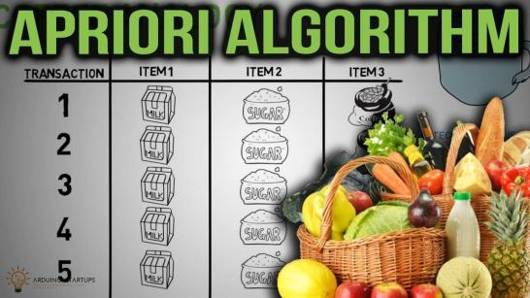
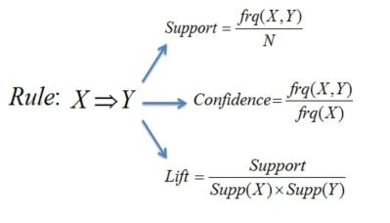
Market Basket Analysis

Slide 28
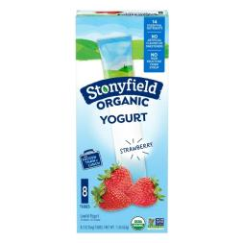


Product Wise Lift
What should I recommend to the customer ?

Slide 29

Product Wise Lift

Slide 30
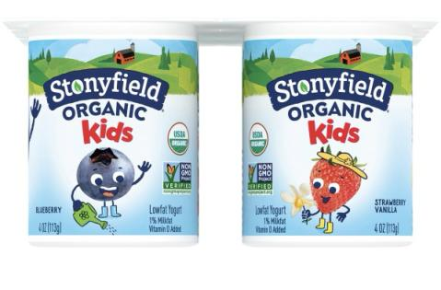
Product Wise Lift
Same Brand Same Product - Different Flavour

Slide 31
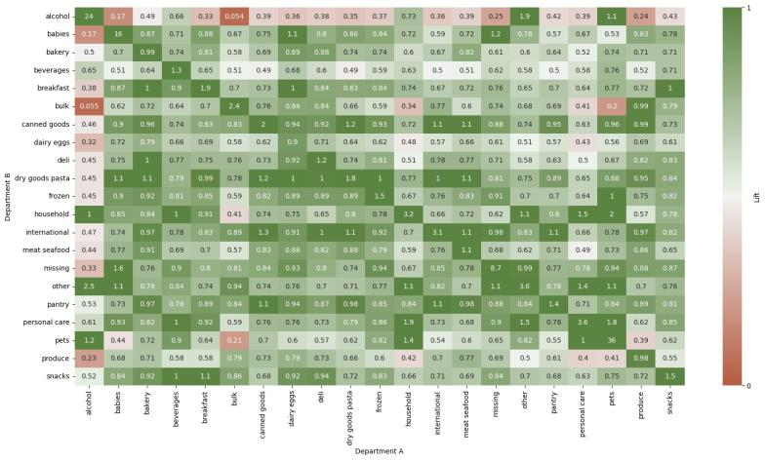
Department Wise Lift

Slide 32
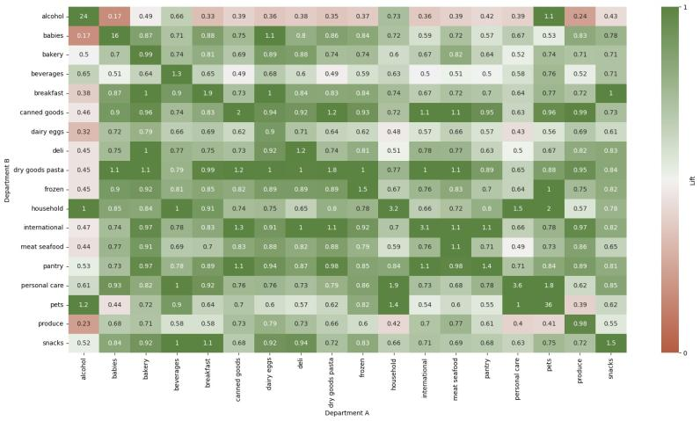
Department Wise Lift

Slide 33
Cross-Selling Enhancement Strategy
1
User adds a product to the cart
2
Find the Cluster of the User
(as defined in our Customer Segment Analysis)
3
Locate the aisle of that product
4
Find the aisle having the highest lift with that aisle for re-ordered products (using Apriori Algorithm) for users in that cluster
5
Recommend the best-selling and most re-ordered product for that aisle

Slide 34
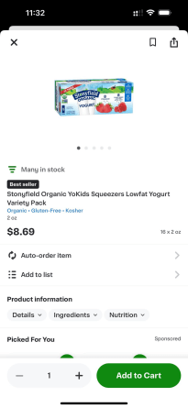
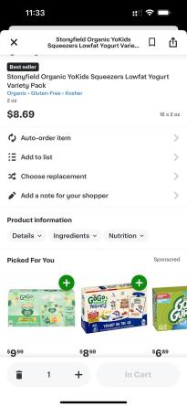


Cross-Selling Enhancement Strategy

Slide 35
Key Recommendations & Takeaways
To optimize Market Basket Analysis, we need to categorize customers into distinct segments based on the user’s preferences.
We can improve the understanding of these preferences by including additional data such as consumer demographics
If we get Revenue information from Instacart, we can run more Customer Targeting analysis, like RFM Analysis, Customer Lifetime Value, etc.
We propose two levels of cross-selling product recommendations
Cross-selling with Highest Lift Product
Recommending products with the strongest lift with aisle
We can leverage A/B Testing to test our recommended approach.
We recommend getting updated data, because of the fast-changing customer dynamics, specially post Covid era

Slide 36
Thank you!
Questions?

Slide 37
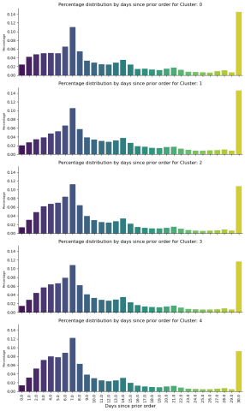
Appendix

